Slide 1
Software Engineering
(CSI 321)
Process Models

Slide 2
Process Model
A software process model is a simplified representation of a software process, presented from a specific perspective.
A software process model is an abstract representation of a software process.

Slide 3
Process Model
Attempt to organize the software life cycle by
      defining activities involved in software production
      order of activities and their relationships
    Every process model must be adapted so that it is used effectively for a specific software project.

Slide 4
Prescriptive Process Models
    Prescriptive software process models have been applied for many years in an effort to bring order and structure to software development.
    Each of these conventional models suggests a somewhat different process flow, but all perform the same set of generic framework activities –
      Communication
      Planning
      Modeling
      Construction
      deployment

Slide 5
Prescriptive Process Models
A prescriptive process model populates a process framework with explicit task sets for software engineering actions.
Prescriptive process models advocate an orderly approach to software engineering.
Prescriptive Process Models are NOT static, they should be adapted to the –
  People
  Problem
  Project

Slide 6
Prescriptive Process Models
The Waterfall Model
Incremental Process Models
Evolutionary Process Models

Slide 7
The Waterfall Model
The oldest paradigm for software engineering.
The Waterfall model, sometimes called the classic life cycle, suggests a systematic, sequential approach to software development.
One phase begins when another completes.
Useful process model in situations where requirements are well-defined and stable, and work is to be proceed to completion in a linear manner.

Slide 8

The Waterfall Model

Slide 9
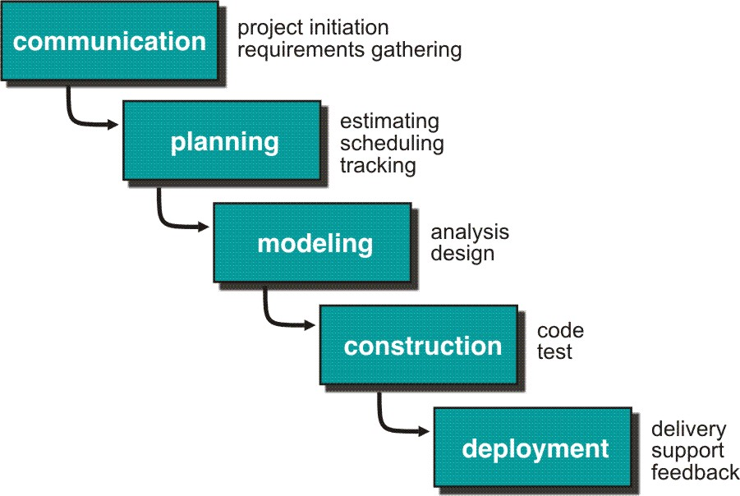
The Waterfall Model

Slide 10
Advantages of the Waterfall model
Identifies systems requirements long before programming begins.
Minimized changes to the requirements as the project proceeds.

Slide 11
Problems of the Waterfall model
The Waterfall model suggests a linear progression of framework activities that is often inconsistent with modern realities( e.g. continuous change, evolving systems, tight timelines). Real projects rarely follow the sequential flow that the model proposes.
The main drawback of the waterfall model is the difficulty of accommodating change after the process is underway. One phase has to be completed before moving onto the next phase.
Inflexible partitioning of the project into distinct stages makes it difficult to respond to changing customer requirements.
  It is often difficult for the customer to state all requirements explicitly
  The customer must be patient

Slide 12
Incremental Process Models
Rather than deliver the system as a single delivery, the development and delivery is broken down into increments with each increment delivering part of the required functionality.
User requirements are prioritized and the highest priority requirements are included in early increments.
Once the development of an increment is started, the requirements are frozen though requirements for later increments can continue to evolve.
Incremental software process models produce software as a series of increment releases.
  The Incremental Model
  The RAD model

Slide 13
The Incremental Model
The Incremental Model combines elements of the Waterfall model applied in an iterative fashion.
Delivers a series of releases , called increments, that provide progressively more functionality for the customer as each increment is delivered.
  Deliver the core product first
  Add on / refine features
  Provide a platform for evaluation by user

Slide 14
The Incremental Model
The incremental process model, like prototyping and other evolutionary approaches, is iterative in nature.
Unlike prototyping, the incremental model focuses on the delivery of an operational product with each increment. Early increments are “stripped down” versions of the final product.
Incremental development is particularly useful when staffing is unavailable for a complete implementation by the business deadline that has been established for the project.
  Early increments can be implemented with fewer people.
  If core product is well received, additional staff can be added to implement the next increment.
  Increments can be planned to manage technical risks

Slide 15
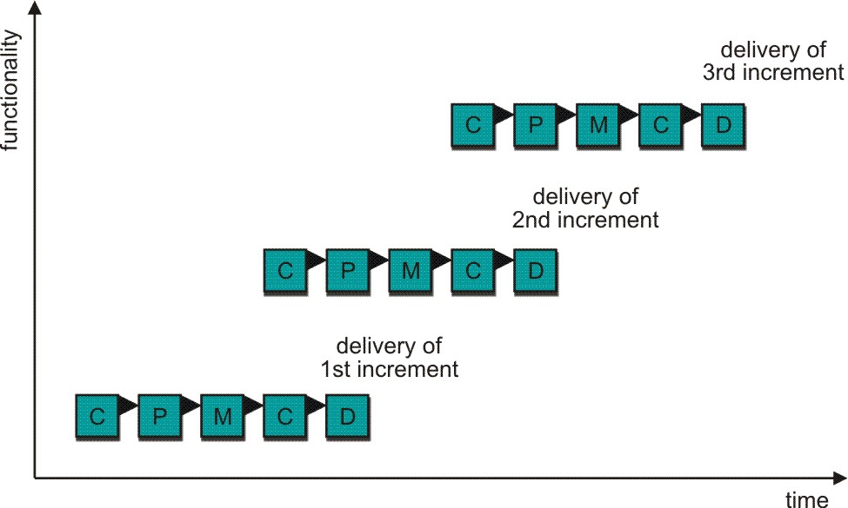
The Incremental Model

Slide 16
Advantages of Incremental Model
Customer value can be delivered with each increment so system functionality is available earlier.
Early increments act as a prototype to help elicit requirements for later increments.
Lower risk of overall project failure.
The highest priority system services tend to receive the most testing.

Slide 17
The RAD Model
  Rapid Application Development (RAD) model
  Incremental software process model that emphasizes a short development cycle ( as little as 60-90 days)
  “High-speed” adaptation of the Waterfall model
  Rapid development is achieved by using a component-based construction approach
  Each major function handled by separate RAD team, and then integrated to form a whole
  RAD model is designed for larger projects that must be delivered in tight time frames

Slide 18
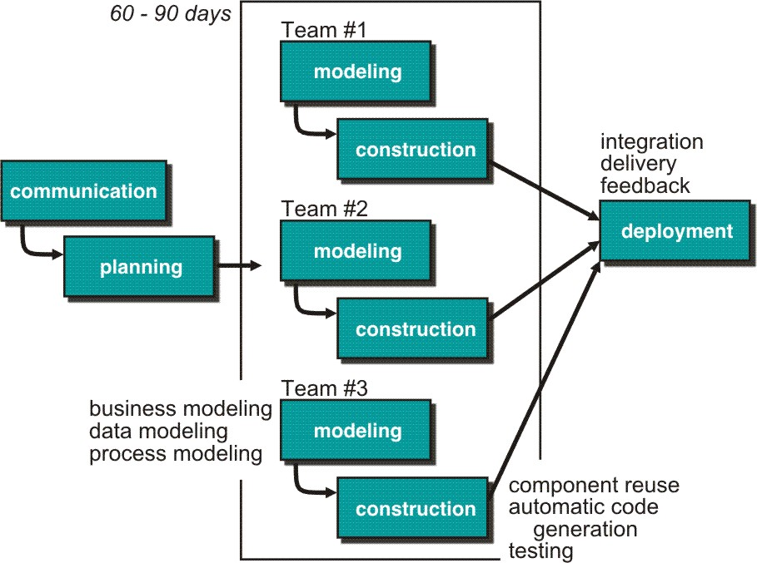
The RAD Model

Slide 19
Drawbacks of the RAD model
For large projects, RAD requires sufficient human resources ( to create right number of RAD teams).
RAD projects fails in the event if developers & customers are not committed to rapid-fire activities within short time frame
If a system cannot be properly modularized, building the components necessary for RAD will be problematic
Not suitable when technical risks are high, or when high performance needs to be achieved through tuning.

Slide 20
Evolutionary Process Models
Evolutionary Process Models produce an increasingly more complete version of the software with each iteration.
Evolutionary models are iterative and are designed to accommodate change.
Produce incremental work products(or working version of the software) quickly.
Based on the idea of developing an initial implementation, exposing this to user comment & refining it through many versions until an adequate system has been developed.

Slide 21
Evolutionary Process Models
These models can be adopted to apply across all software engineering activities –from concept development to long-term system maintenance.
  Prototyping
  Spiral development

Slide 22
Prototyping
Designing and building a scaled-down but functional version of a desired system is known as prototyping.
Prototyping is an iterative process of systems development in which requirements are converted to a working system that is continually revised through close collaboration between an analyst and users.
  Requirements quickly converted to a working system
  System is continually revised
  Close collaboration between users and analysts
Start with a "quick-and-dirty" prototype (that provides minimal functionality), repeat process, refining the prototype each time, stop when prototype is a working system.

Slide 23
Prototyping
Objective is to understand the customer’s requirements & hence develop a better requirements definition for the system.
  Should start with poorly understood requirements to clarify what is really needed.
    The prototype serves as a mechanism for identifying software requirements

Slide 24
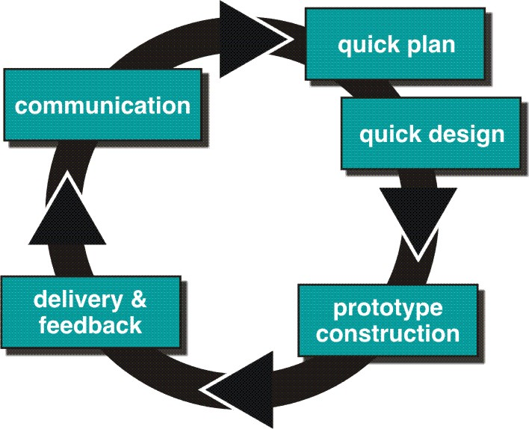
Prototyping

Slide 25
Prototyping: Pros & Cons
Pros | Cons
Gets working system to users quickly | Fast paced. Hard to conduct careful, methodical analysis
Reassures users that the project is progressing | Initial design decisions have long term staying power
Quickly refines true requirements | Problems may come to light late in design, requiring re-design

Slide 26
The Spiral Model
An evolutionary software process model that couples the iterative nature of prototyping with the controlled & systematic aspects of the Waterfall model.
Unlike other process models that end when software is delivered, the spiral model can be adapted to apply throughout the life of the computer software.
Realistic approach to the development of large-scale software.
Software is developed in a series of evolutionary releases.

Slide 27
The Spiral Model
Process is represented as a spiral rather than as a sequence of activities with backtracking.
Each loop in the spiral represents a phase in the process.
No fixed phases – loops in the spiral are chosen depending on what is required.
Risks are explicitly assessed and resolved throughout the process.

Slide 28
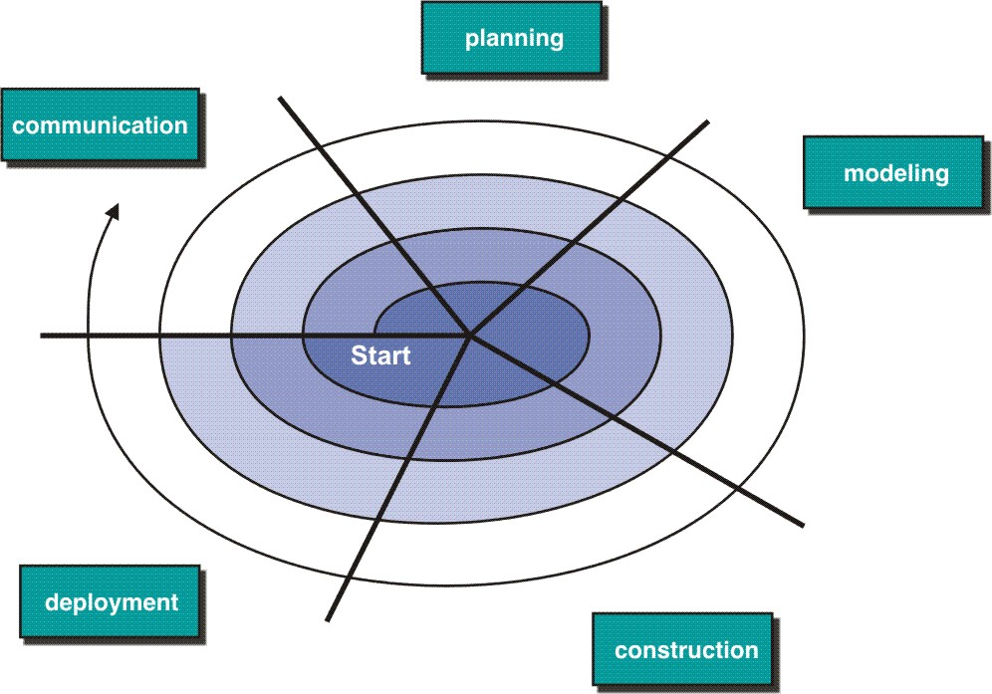
The Spiral Model

Slide 29
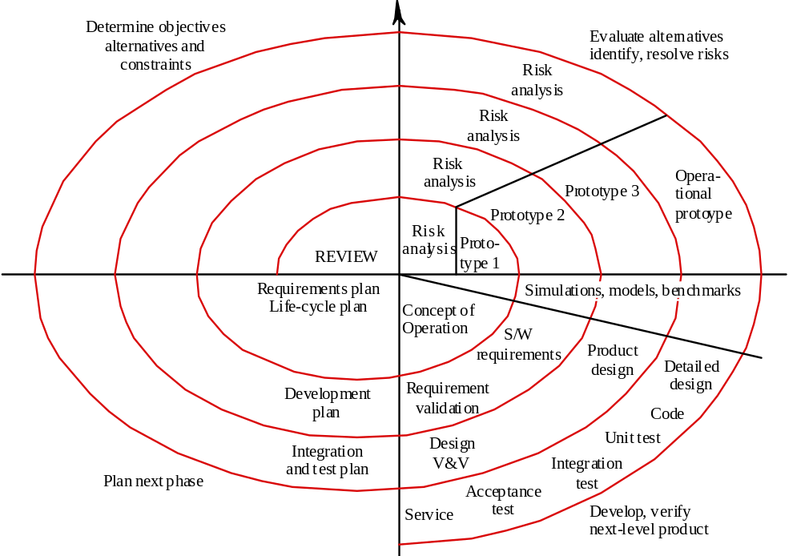
The Spiral Model

Slide 30
The Spiral model sectors
Each loop in the spiral is split into four sectors:
1) Objective setting
  Specific objectives for the phase are identified
2) Risk assessment and reduction
  Risks are assessed and activities put in place to reduce the key risks
3)Development and validation
  A development model for the system is chosen which can be any of the generic models
4) Planning
  The project is reviewed
  A decision is made whether to continue with a further loop of the spiral
  If decided to continue, plans are drawn up for the next phase of the project

Slide 31
Weaknesses of the Spiral model
Only suitable for large-scale software
Only suitable for internal (in-house) software
Not suitable for fixed-budget development
It may be difficult to convince customers that the evolutionary approach is controllable.
Demands considerable risk assessment expertise & relies on this expertise for success.
Projects fail if major risks are not uncovered & managed properly.

Slide 32
Specialized Process Model
Component-Based Development Model
Formal methods Model
Aspect-Oriented Model

Slide 33
Specialized Process Model
Component-Based Development Model
  Component-Based Model emphasizes component reuse and assembly
  COTS software components can be used when software is to be built. These components provide targeted functionality with well-defined interfaces that enable the component to be integrated into the software.
  Component-based development model incorporates many of the characteristics of the spiral model. It is evolutionary in nature, demanding an iterative approach to the creation of software
  The model composes applications from prepackaged software components

Slide 34
Specialized Process Model
Component-based development model incorporates the following steps –
  Available component-based products are researched and evaluated for the application domain
  Component integration issues are considered
  A software architecture is designed to accommodate the components
  Components are integrated into the architecture
  Comprehensive testing is conducted to ensure proper functionality

Slide 35
Specialized Process Model
Formal Methods Model
  Encompasses a set of activities that leads to formal mathematical specification of computer software
  Encourages a mathematically based approach to software development & verification
  A variation on this approach, called clean-room software engineering, is currently applied by some software development organizations.
  Provide a mechanism for eliminating many of the problems that are difficult to overcome using other SE paradigms. Ambiguity, incompleteness, and inconsistency can be discovered & corrected more easily through the application of mathematical analysis.

Slide 36
Specialized Process Model
Formal methods model offers the promise of defect-free software. BUT, it is not widely used –
  Development of formal models is quite time-consuming & expensive
  Because few developers have the necessary background to apply formal methods, extensive training is required
  It is difficult to use the models as a communication mechanism for technically unsophisticated customers.

Slide 37
Specialized Process Model
Aspect-Oriented Model
  Accommodates cross-cutting concerns that spans the entire system architecture
  AOSD defines “aspects” that express customer concerns that cut across multiple system functions, features, and information

Slide 38
Unified Process Model
The Unified Process is a “use-case driven, architecture-centric, iterative and incremental” software process designed as a framework for UML methods and tools.
UP phases are similar in intent to the generic framework activities .
A modern process model that is organized into five phases but that separates activities from these phases.

Slide 39
Five Phases of Unified Process Model
Inception
  Establish the business case for the system.
Elaboration
  Develop an understanding of the problem domain and the system architecture.
Construction
  System design, programming and testing.
Transition
  Deploy the system in its operating environment.
Production
  On-going monitoring & support

Slide 40
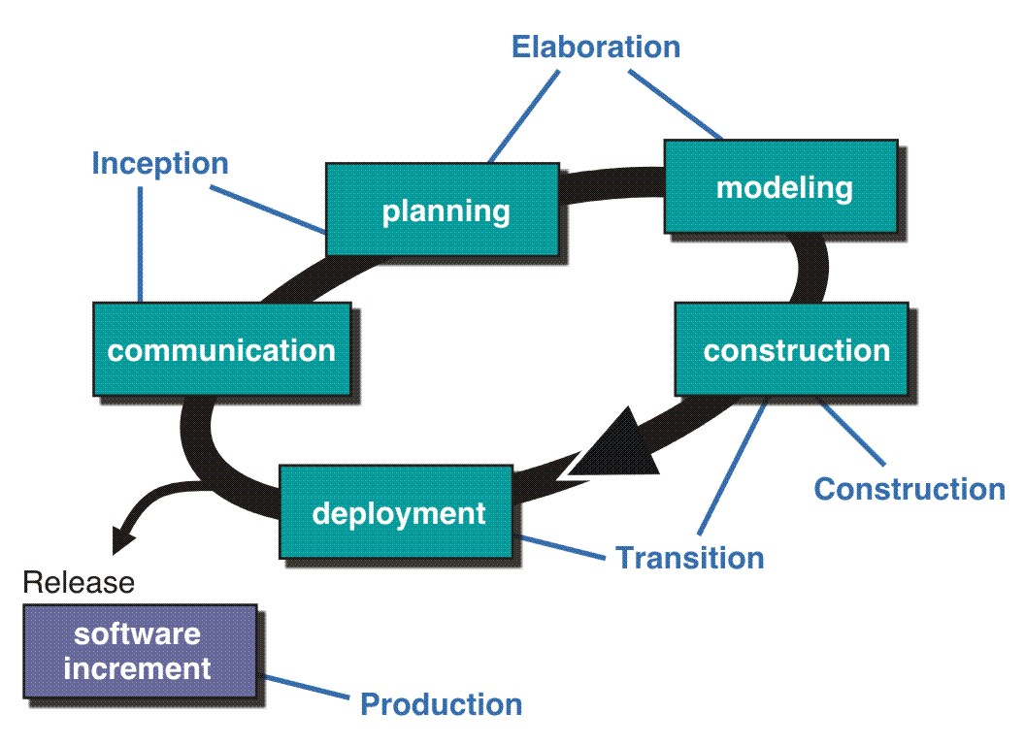
Unified Process Model

